Slide 1
Student Result Management System
Submitted to: Mrs. Vandana Bansala Submitted by: Dhruv Jain
Abhishek Kumar
Anubhav Thapa

Slide 2
CONTENT
OVERVIEW
APPROACH
PRIMARY GOALS
APPLICATIONS
PROGRESS
REFERENCES

Slide 3
OVERVIEW
In our day to day life, we come across various exam results. How efficiently it produce someone’s result by just filling in student details.
Have you ever thought of creating one!
By creating a system that accepts the students details an input and generates the desired as output.

Slide 4
APPROACH
Top Down Approach.
3 Section
Result section – end goal
Database – native queries
Admin section – activities like add database and modification
Authentication for admin section
Clubbing things to get work done

Slide 5
PRIMARY GOALS
Performing various database queries.
Automatic add and modify student data.
Enter authentication system for admin.
Generate the result.

Slide 6
APPLICATIONS
Create and manage school and institute result portals.
Create other types of management systems.

Slide 7
Technologies used
Code editor- VS Code
HTML for the page landing, CSS, JS and bootstrap to make it attractive and responsive.
An Apache distribution XAMPP for the database and
PHP for the backend.

Slide 8
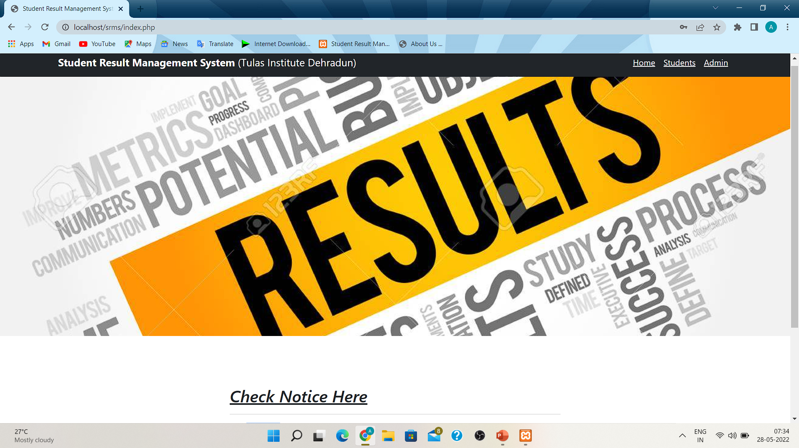
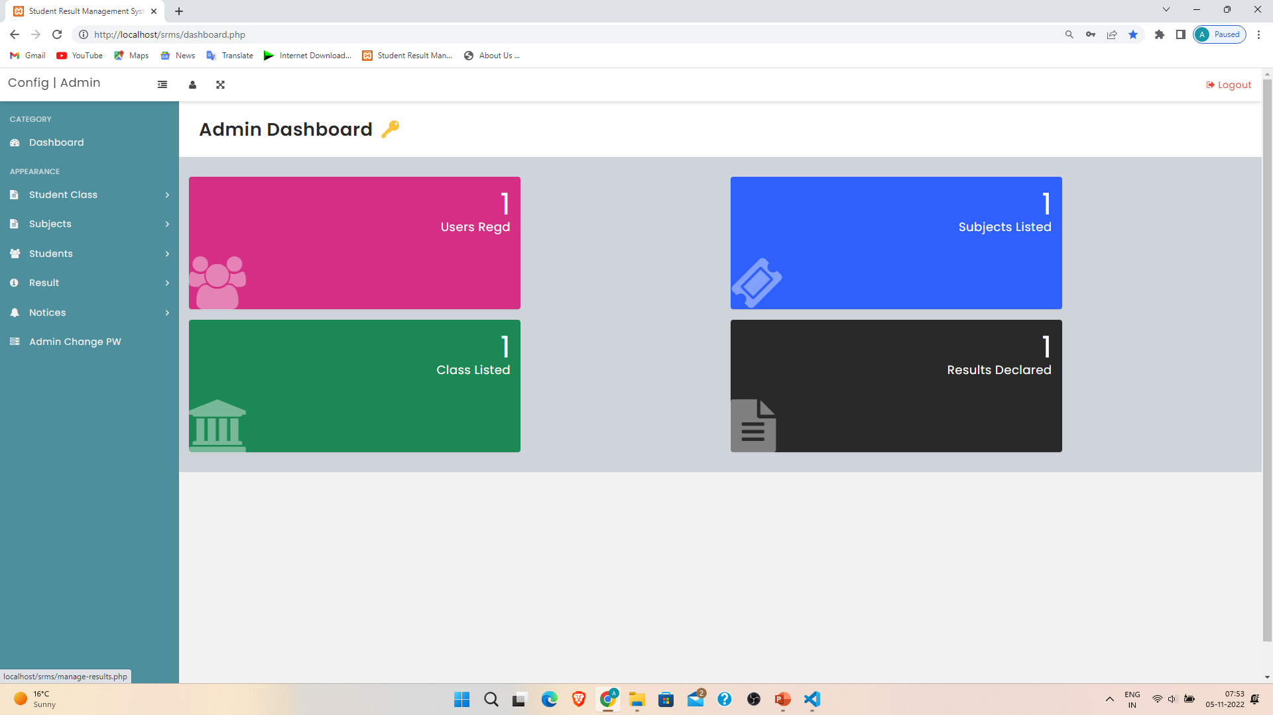
Progress
100% done with the front end part.
Have created the login forms, homepage, dashboard.
Database setup Complete.
Fetching result section all set.

Slide 9
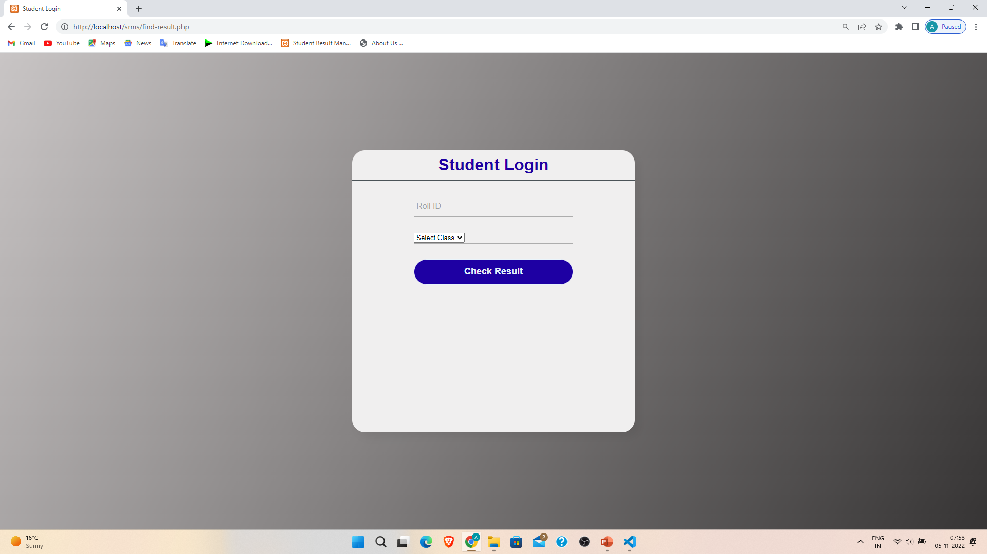
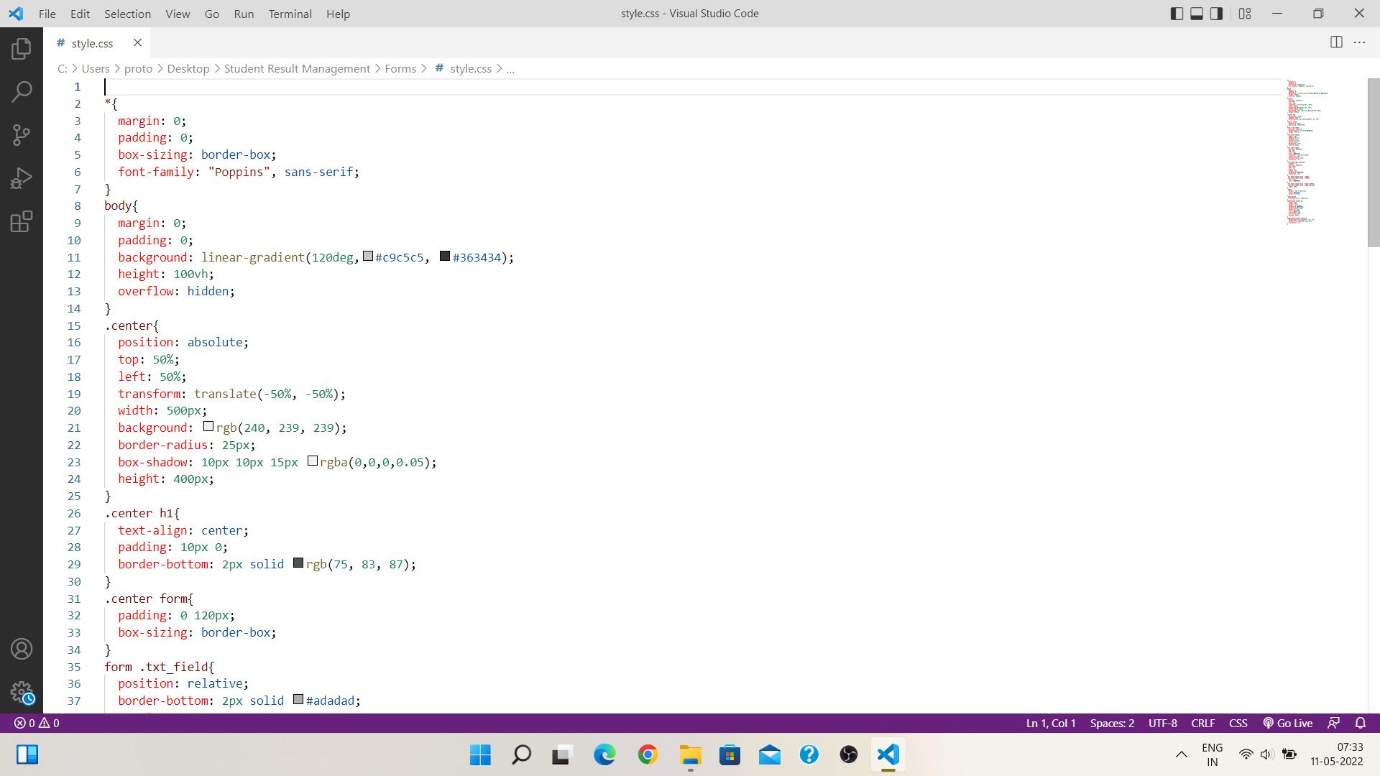
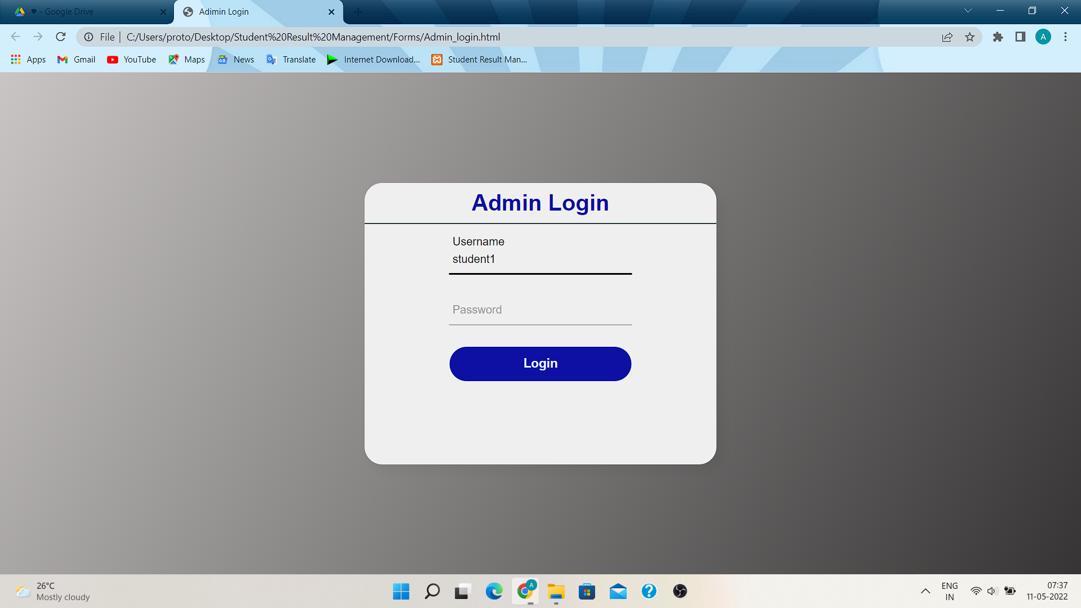
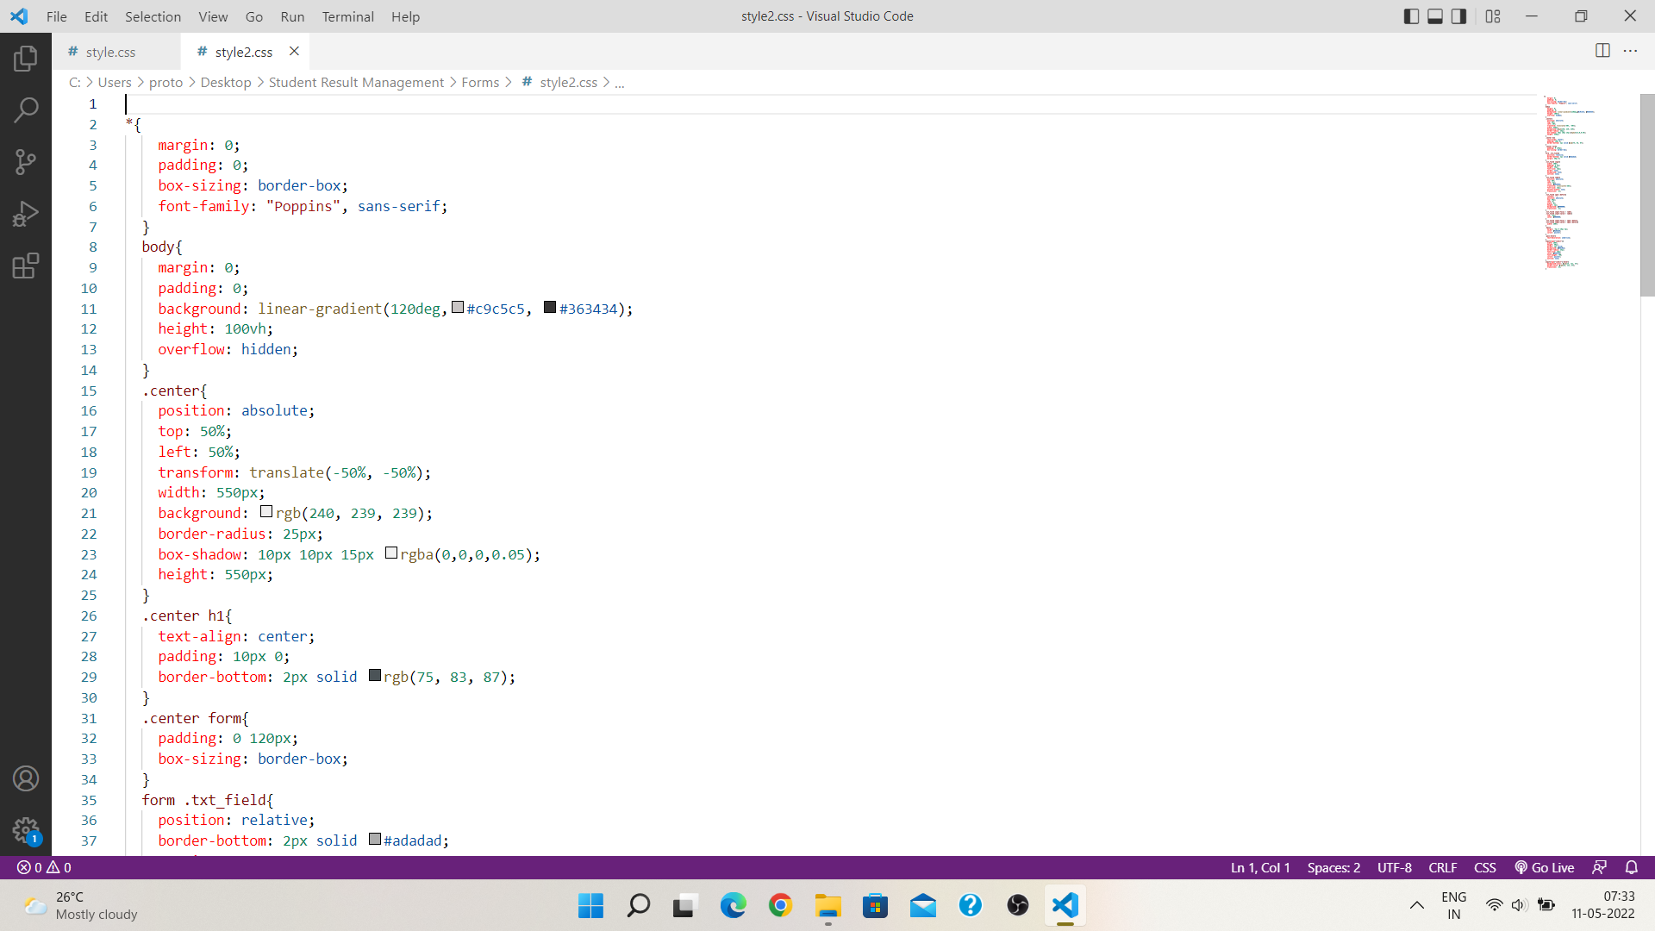

Slide 10
References
www.geeksforgeeks.org
www.javapoint.com
www.apnikaksha.net
References from Youtube
www.Codewithharry.com

Slide 11
Thank you

